Slide 1
GULFMET Progress Report
Online, on 8th Oct. 2020

Slide 2
GULFMET legal entity
GULFMET, is a Regional Metrology Organization (RMO) established under the auspices of GCC Standardization Organization (GSO),.
GULFMET was established pursuant to GSO Board of Directors' decision in its meeting No.12 (Kuwait, 2 June 2010).
GULFMET is not independent and has no legal entity

Slide 3
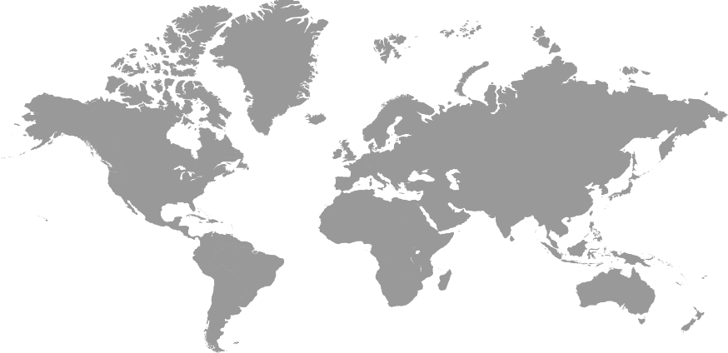


Members & Associated Members
الدول الأعضاء والدول المشاركة في التجمع الخليجي للمترولوجيا
BOSNIA AND HERZEGOVINA
IMBIH
TURKY
UME
SOUTH KOREA
KRISS
HONG KONG
SCL
EGYPT
7 Members
NIS
5 Associated Members

Slide 4

GULFMET STRUCTURE
GSO Board of Directors
GSO Technical Council
GSO General Secretariat
Steering Committee of Metrology
National Measurement lab.
(NMIs)
GULFMET Presidency
GULFMET Secretariat
Technical committees (TCs)
NEW
NEW

Slide 5
GULFMET TC legal
SCOPE
Metrological legislation that covers the following:
legal measurement units;
Technical regulations and standard for measuring devices and instruments that cover metrological, technical and administrative requirements.
Legal metrological control over measuring instruments.
Legal metrological control over prepackaged goods.
Monitor the manufacture, import, repair and sale of measuring instruments.
Metrological supervision and market survey procedures.
Procedures for adopting the type approval for measuring instruments subject to legal control
Metrological fee.

Slide 6
GULFMET TC legal
SCOPE
2. Procedures for monitoring and inspection of legal measuring instruments
3. Registration / certification procedures for legal measuring instruments
4. Procedures for authorization / designation of the inspection bodies for legal measuring instruments.
4. Organizing inter- comparisons programs in the field of legal metrology.
5. Representation of GULFMT in OIML activities

Slide 7
GULFMET TC legal
SCOPE
2. Procedures for monitoring and inspection of legal measuring instruments
3. Registration / certification procedures for legal measuring instruments
4. Procedures for authorization / designation of the inspection bodies for legal measuring instruments.
4. Organizing inter- comparisons programs in the field of legal metrology.
5. Representation of GULFMT in OIML activities

Slide 8
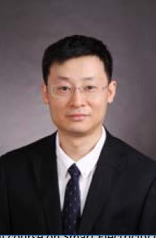
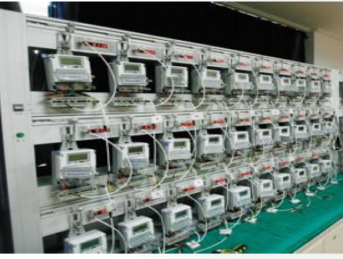
Smart Meters
Online Oct.12-14, 2020
Mr. Wang Lei
Electricity and Magnetism Division
National Institute of Metrology,
China
The training course on Smart Electricity Meter is aimed specifically at training trainers who will lead the development of knowledge and skills of verification officers and the establishment of uniform understanding in national or regional level in electricity measurement

Slide 9
Scope of RLMO Round Table
Share training materials, including e-learning modules, among RLMOs;
GULFMET would like to coordinate with other RLMO to develop e-learning modules
We can share cost of such e-learning project
Send representatives to each other’s RLMO meetings;
GULFMET consider this option to improve the GULFMET TC Performance
GULFMET TC members are invited by EURAMET and APMP to attend TCs meeting

Slide 10
Scope of RLMO Round Table
Formalize the relationships between the RLMOs and OIML, including development of Terms of Reference (ToR) for the RLMO RT. The ToR could address:
  Should OIML formalize what it considers to be an RLMO (e.g., what kind of grouping is/represents an RLMO)?
  Should there be membership/participation criteria for the RLMO RT?
  RLMO RT should consider the BIPM- JCRB experience in the above issues.
  RLMO advisory committee with be membership/participation criteria shall be proposed

